Slide 1
Capstone project

Slide 2
Introduction:
-A person, Robert wants to open a new BBQ joint in bogota, colombia.
-Due to bogota's high diversity and very large size. he asked for help in order to find best place to open a new BBQ joint in bogota, colombia.
-Bogota's has 20 different localities (districts) and we aim to find best place.
-we need to choose best locality that has good amount of customers and low amount of competition.

Slide 3
Data
-The localities of bogota, colombia from wikipedia https://es.wikipedia.org/wiki/Anexo:Localidades_de_Bogot%C3%A1
-Import the coordinates (latitude, longitude) ot these Localities of Bogotá from Open Street Map APIs
-From Foursquare we will need following venues data:
->The BBQ joint venues of the Localities
->The offices venues of the Localities
->The universities venues of the Localities
-We will then leverage the data in order to determine which locality is the most appropriate in order to locate the BBQ joint

Slide 4
Methodology
For each locality , all office employees, universities and BBQ joint venues data have been collected from foursquare.
Then for each locality, the sums of the office, university and BBQ joints were computed.
For each of this 3 categories , a weight has been defined according to what robert's considers the most important.
BBQ joints have been weighted with -1 , since robert wants to avoid concurrence.
universities have been weighted with 1.5, since students are good customers.
offices have been weighted with 2 , since employees are even better customers.
NOTE-weights are modified according to importance of each category.
Lastly , a score was computed for each locality as the weighted sum of the number of venues in each of the 3 categories

Slide 5
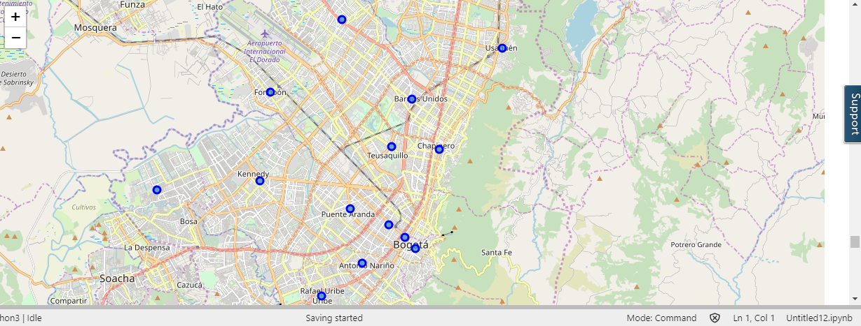
LOCALITIES OF BOGOTA , COLOMBIA:

Slide 6
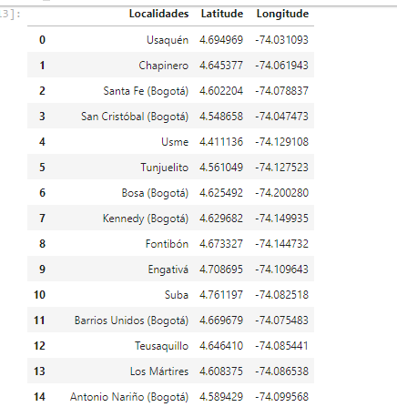

Slide 7
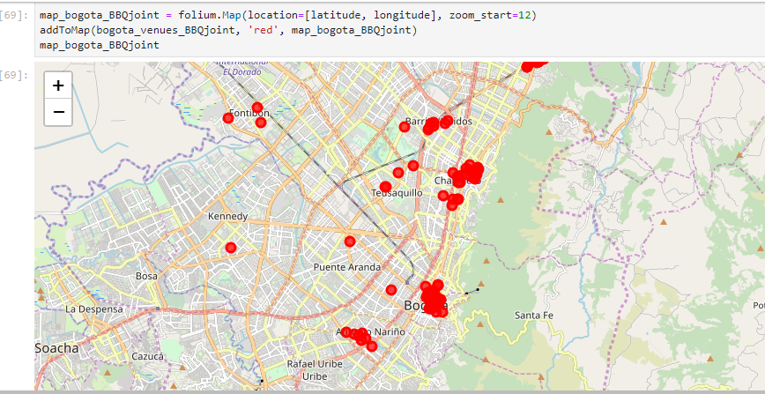
BBQ JOINTS IN BOGOTA, LOCALITIES:

Slide 8
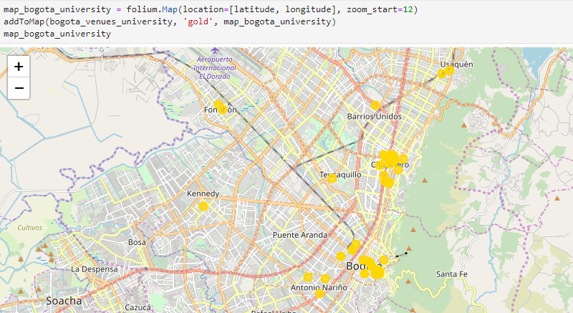
UNIVERSITIES IN BOGOTA, LOCALITIES:

Slide 9
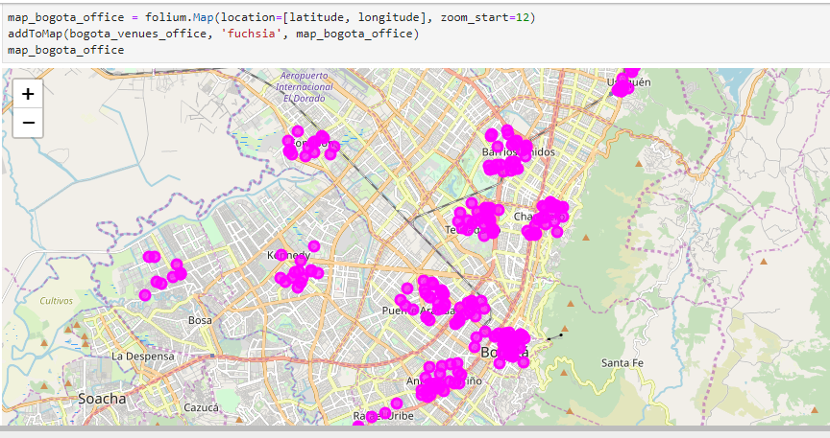
OFFICES IN BOGOTA LOCALITIES:

Slide 10
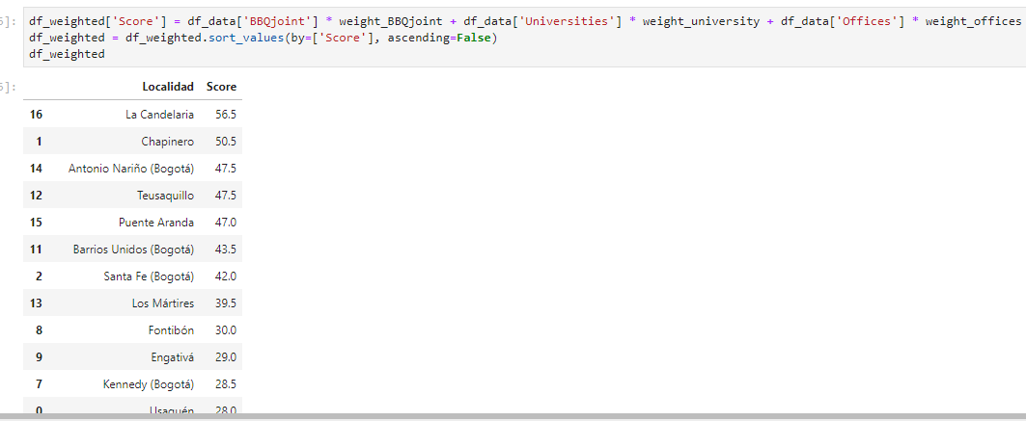
RESULTS:

Slide 11
The Locality with the best score is “la candelaria” with 56.5, being the best option
Follows closely “chapinero” with 50.5.
These options maximize the number of potential customers from offices and universities and at the same time have not too large competence.

Slide 12
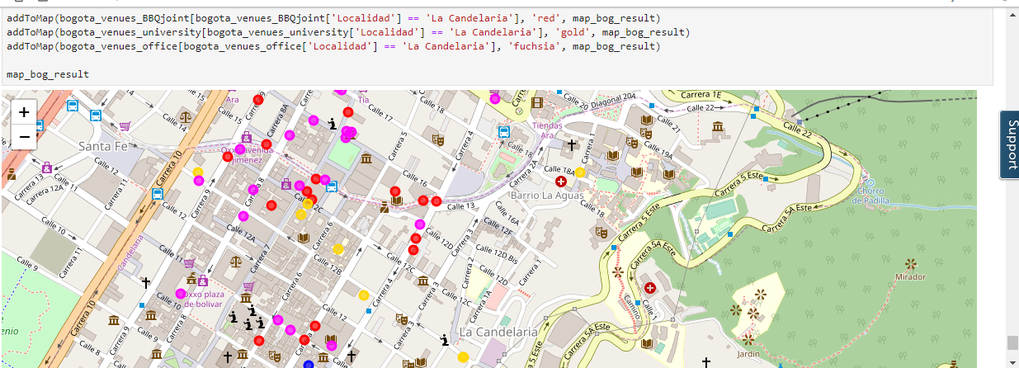
BEST PLACE FOR BBQ JOINT IS LA CANDELARIA:

Slide 13
RECOMMENDATION:
The following analysis can be improved with following extensions:
-Consider more categories for example like “night life” which is also a good source for customers. But also like “Restaurants”, which even if not BBQ joints may be some concurrence if too many.
-In the locality itself, it can also be computed the distance between all the venues in order to find a place with the most number of potential customers.
Using smaller geographical areas like Neighborhoods could improve the accuracy for the scores.

Slide 14
CONCLUSION:-
La Candelaria Locality is the best option for robert in order to open his BBQ Joint.

